Slide 1
IENG 461 – System Safety I
Lecture 8 – Failure Modes and Effects Analysis (FMEA)
James R. Harris, Ph.D., P.E.

Slide 2
Failure Modes and Effects Analysis
Overview of tonight’s topics
  Review/practice fault tree analysis (FTA)
  Introduction
  FMEA execution
  Practical example
  Homework 4 assignment
  Project discussion

Slide 3
Failure Modes and Effects Analysis
Introduction…
Why FMEA?
Top 3 U.S.-based warranty providers in 2010 ($ in millions):
  General Motors Co. - $3,204
  Hewlett-Packard Co. - $2,689
  Ford Motor Co. - $1,522

Slide 4
Failure Modes and Effects Analysis
Introduction
Initiated for the military
  MIL-P-1629, “Procedures for Performing a Failure Mode, Effects, and Criticality Analysis” (1949)
IEC 60812 - Analysis Techniques For System Reliability – Procedure For Failure Mode And Effects Analysis (FMEA)
Inductive reasoning - Bottom up technique (different from FTA)

Slide 5
Failure Modes and Effects Analysis
Methodology…
Answering a series of questions:
  What can fail?
  How does it fail?
  How frequently will it fail?
  What are the effects of the failure?
  What is the reliability/safety consequence of the failure?

Slide 6
Failure Modes and Effects Analysis
Methodology…
Risk Priority Number (RPN) = a combination of severity, occurrence (freq.), and detection. (Raytheon method below…)
Severity: Scale 1-10, 1=no impact, 10=catastrophic impact/hazardous
Occurrence: Scale 1-10, 1=predicted <3 defects/million, 10=>500K defects/million
Detectability: Scale 1-10, 1=always detected by current control plan, 10=unable to detect - (ability to detect problem before reaching end user)

Slide 7
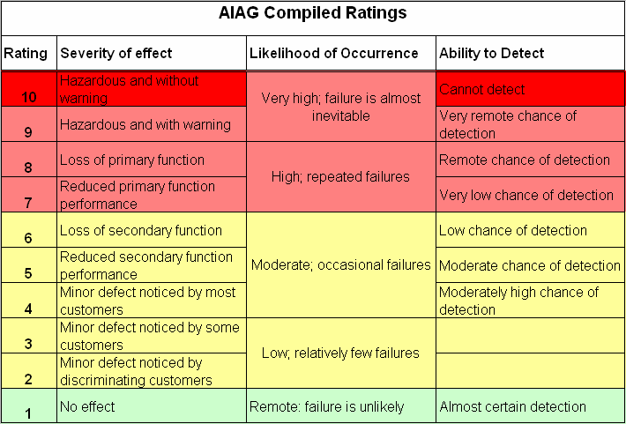
AIAG = Automotive Industry Action Group

Slide 8
Failure Modes and Effects Analysis
Item/ Function | Failure Mode | Failure Effect | SEV | Failure Cause | OCC
Brake cable: Provides adjustable and calibrated movement between the brake lever and brake caliper | Cable breaks | Operator cannot close brake calipers and wheel does not slow down. Incident possible. | 10 | Cable wiring corrosion (wrong material) | 5
 |  |  |  | Fatigue cracks in cable (inadequate thickness) | 2
 | Cable binds | Increased cable/sheath friction and increased effort to close brake calipers. | 7 | Cable bend or kink due to misrouting | 3
 |  |  |  | Inadequate lubrication between cable/sheath | 5

Slide 9
Failure Modes and Effects Analysis
ID # | Component/Function | Failure mode | Severity | Failure cause | Occur. | Failure effect | Detect. | RPN | Recommendations
5 “whys”

Slide 10
Failure Modes and Effects Analysis
Five Whys (to assist with recommendations)
Why does the cable break? (Because in-use stress exceeds the strength of the cable).
Why does the in-use stress exceed the strength of the cable? (Because the strength of the current cable material can degrade under extreme environmental conditions).
Why does the strength of the current cable material can degrade under extreme environmental conditions? (Because the current cable material corrodes when exposed to extreme hot and moist operating environments).

Slide 11
Failure Modes and Effects Analysis
Five Whys
Why does the current cable material corrode when exposed to extreme hot and moist operating environments? (Because the current material is not suitable for the most extreme operating conditions for the all-terrain bicycle).
Why is the current cable material not suitable for the most extreme operating conditions for the all-terrain bicycle? (Because the cable supplier selected the wrong material for the brake cable).

Slide 12
Failure Modes and Effects Analysis
Example:
  Coffee maker (pick two components)
ID # | Component/Function | Failure mode | Severity | Failure cause | Occur. | Failure effect | Detect. | RPN | Recommendations

Slide 13
Failure Modes and Effects Analysis
Strengths of the technique:
  Documentation of system safety and risk-based product/process evaluation (product liability)
  Feedback to designers of product/process elements which influence reliability
Weaknesses of the technique:
  Difficult to show relationship of various product/process failure modes (FTA better at this)

Slide 14
Failure Modes and Effects Analysis
FMEA goals (from Carl Carlson, Senior Reliability Engineer) --- FMEA should…
  Drive product design or process improvements
  Include integration and interface failure modes
  Be completed during the "window of opportunity" where it can most effectively impact the product or process design
  Include the right people on the FMEA team throughout the analysis (4-8 people per team)

Slide 15
Failure Modes and Effects Analysis
Summary
FMEA is inductive (specific to general) technique
FMEA may be better pre-incident tool than fault tree analysis
Risk priority number (SxOxD) helps prioritize risk mitigation (risk reduction)

Slide 16
Failure Modes and Effects Analysis
Preview of next week
  Hazard Operability Analysis (HAZOP)
  Review of topics for Exam 2 (Oct. 31)
Homework 4: (1) Complete a fault tree for any four top level events (four fault trees) concerning your semester project (complete to the 4th level). (2) Complete an FMEA for at least four components (or process steps) concerning your semester project. Identify three failure modes for each component within each FMEA. Submit electronically by 5:30pm, 10/31 using lastname_HW4 as filename.
Questions?

